Slide 1






A2A ARCHITECTURE OVERVIEW
A comprehensive overview of A2A client-server interactions.
SRI RAMA HARISH NIMMALA

Slide 2



UNDERSTANDING A2A CLIENT SERVICES
01
A2A CLIENT DEFINITION
An A2A Client is an application or agent designed to utilize A2A services for its operations.
02
ROLE OF A2A CLIENT
The A2A Client sends requests to the A2A Server, initiating interaction and service consumption.
03
TYPES OF A2A CLIENTS
Various applications can serve as A2A Clients, each tailored to specific service needs and architectures.
04
INTERACTION WITH A2A SERVER
The A2A Client communicates by sending tasks or commands, facilitating server-side processing.
05
IMPORTANCE OF A2A CLIENT
An effective A2A Client enhances service efficiency and responsiveness in distributed systems.
06
EXAMPLES OF A2A CLIENT USAGE
Common examples include mobile apps, web applications, and automated agents utilizing A2A services.

Slide 3

UNDERSTANDING A2A SERVER FUNCTIONALITY
01
02
03
04
A2A SERVER AS A MIDDLEWARE
HTTP ENDPOINT EXPOSURE
TASK MANAGEMENT
CLIENT-SERVER INTERACTION
The A2A Server acts as a middleware that facilitates communication between different applications, ensuring smooth task execution and request handling.
The server exposes an HTTP endpoint, allowing clients to send requests and interact with the server efficiently.
It is responsible for receiving requests and managing the execution of tasks, ensuring that they are processed in a timely manner.
The interaction is illustrated by an arrow from the A2A Client to the A2A Server, representing the flow of requests and responses.
05
06
07
08
INITIATION OF TASKS
SCALABILITY
RELIABILITY
INTEGRATION CAPABILITIES
The arrow labeled 'tasks/send' signifies the initiation of tasks, marking the beginning of the communication process.
A2A Server provides scalability options, allowing it to handle multiple requests and tasks concurrently, enhancing performance.
The architecture ensures reliability in task execution, reducing the chances of errors during communication between clients and the server.
A2A Server can integrate with various systems, making it a versatile component in the A2A architecture.

Slide 4
TASK MANAGEMENT IN A2A ARCHITECTURE
TASK IDENTIFICATION
TASK STATES OVERVIEW
A2A SERVER TO TASK LINK
TASK MANAGEMENT IMPORTANCE
Each task in the A2A system is uniquely identified by an ID#, ensuring precise tracking and management throughout its lifecycle.
Tasks can transition through various states: submitted, working, input-required, completed, failed, and canceled, reflecting their progress.
An arrow from the A2A Server to Task signifies the central role of task management within the A2A Client-Server architecture.
Effective task management is crucial for optimizing workflows and ensuring timely completion of tasks in an A2A system.
LIFECYCLE MANAGEMENT
STATE TRANSITION MECHANISM
FAILURE AND CANCELLATION HANDLING
INPUT-REQUIRED STATE
Understanding the lifecycle of a task helps in anticipating issues and managing dependencies effectively.
The system's ability to manage state transitions is vital for maintaining operational efficiency and user satisfaction.
Proper mechanisms must be in place to handle task failures and cancellations to minimize disruptions.
The 'input-required' state emphasizes the need for user interaction, crucial for tasks that depend on external inputs.

Slide 5





UNDERSTANDING ARTIFACT OUTPUTS
ARTIFACT SIGNIFIES TASK OUTPUTS
TYPES OF OUTPUTS: TEXTPART, FILEPART, DATAPART
TASK OUTPUT FLOWS TO ARTIFACT
IMPORTANCE OF ARTIFACTS
An Artifact represents the outputs generated from various tasks, encapsulating different types of data.
There is a direct relationship where the output from a task is represented as an Artifact, indicating the flow of information.
Artifacts are crucial in the A2A architecture for tracking and managing the outputs of tasks effectively.
Artifacts can contain multiple parts including TextPart for textual data, FilePart for files, and DataPart for structured data.

Slide 6
MESSAGE COMMUNICATION OVERVIEW
MESSAGE AS A COMMUNICATION UNIT
PARTS OF A MESSAGE
DIALOGUE ILLUSTRATION
CLIENT-AGENT INTERACTION
The Message represents the communication between the user and the agent, encapsulating the dialogue process between them.
Messages are composed of various Parts such as TextPart, FilePart, etc., which define the content and format.
An arrow visualizes the interaction, showing the flow of communication: Client ↔ Message ↔ Agent, illustrating the dialogue structure.
The interaction emphasizes the importance of real-time communication in A2A architecture, ensuring effective message exchange.
TYPES OF MESSAGE PARTS
BIDIRECTIONAL COMMUNICATION
ROLE OF MESSAGE STRUCTURE
IMPORTANCE OF CLARITY
Different types of message parts include text, files, and other data formats, enabling flexibility in communication.
The arrow signifies bidirectional communication, highlighting that messages can flow in both directions between client and agent.
The structure of a message is crucial in defining how data is conveyed, processed, and understood by both parties.
Clear and structured messaging is essential for maintaining effective communication and understanding between the client and agent.

Slide 7




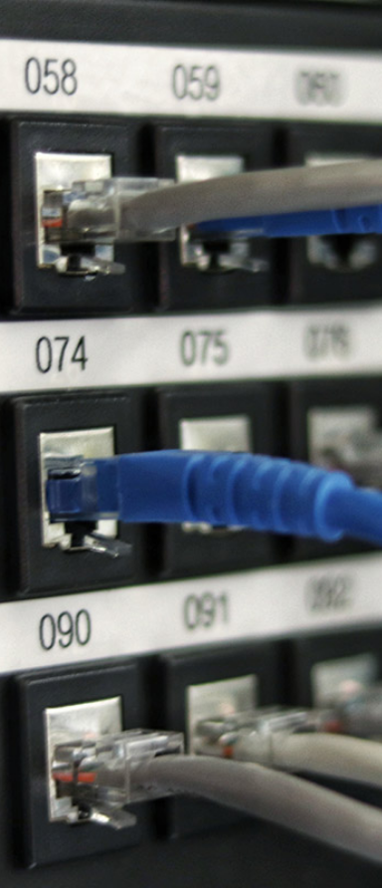

REAL-TIME TASK STREAMING UPDATES
STREAMING (SSE): REAL-TIME UPDATES
TASKSTATUSUPDATEEVENT
TASKARTIFACTUPDATEEVENT
A2A SERVER TO STREAMING
LONG-RUNNING TASKS
Streaming with Server-Sent Events (SSE) is ideal for long-running tasks, ensuring users receive updates without delays.
This event provides real-time updates on the status of ongoing tasks, enhancing user awareness and responsiveness.
This event relays updates about task artifacts, allowing users to track changes and maintain data integrity throughout the process.
The A2A Server communicates directly with the Streaming service, facilitating immediate updates to clients.
Streaming is particularly beneficial for tasks that take a significant amount of time, as it keeps users informed continuously.

Slide 8
UNDERSTANDING PUSH NOTIFICATIONS
PUSH NOTIFICATIONS ARE ESSENTIAL
SERVER-SENT UPDATES
WEBHOOK URL USAGE
EVENT-DRIVEN COMMUNICATION
Push notifications are critical for real-time communication, allowing servers to send timely updates to clients directly.
The server is responsible for sending task updates to clients via push notifications, ensuring they receive real-time information.
Clients utilize a webhook URL to receive updates from the server, facilitating seamless communication between both parties.
The integration of webhook events allows for event-driven architecture, improving responsiveness and efficiency in updates.
ARROW REPRESENTATION
REAL-TIME INTERACTION
ENHANCING USER ENGAGEMENT
INTEGRATION CHALLENGES
The arrow from the A2A Server to Push Notifications visually represents the flow of updates and communications in the system.
Push notifications promote real-time interaction, enabling clients to stay updated on tasks and events as they happen.
Utilizing push notifications can significantly enhance user engagement by providing timely and relevant information to clients.
While beneficial, integrating push notifications can pose challenges regarding security, reliability, and performance.

Slide 9
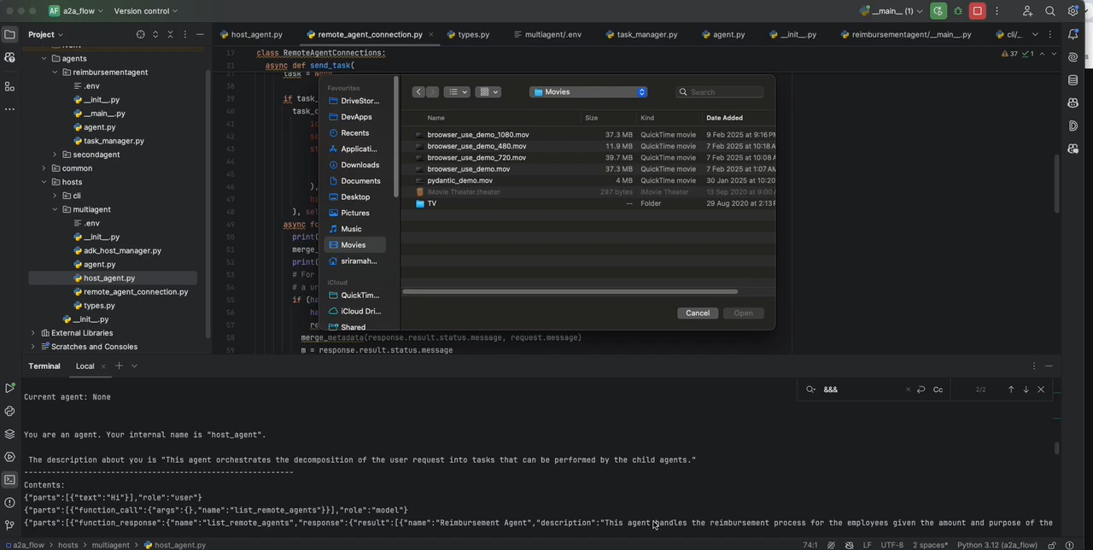
Demo

Slide 10
AGENT CARD INFORMATION OVERVIEW
AGENT CARD - CORE COMPONENT
The Agent Card is a vital element in the A2A architecture, encapsulating the essential capabilities and skills of the agent.
CAPABILITIES - WHAT AGENTS CAN DO
Agents possess various capabilities that enable them to perform specific tasks and functions within the A2A architecture.
SKILLS - EXPERTISE OF AGENTS
The skills of agents are critical for ensuring effective communication and task execution in the A2A framework.
ENDPOINT URL - ACCESS POINT
Each Agent Card includes an endpoint URL, which serves as the access point for client-server interactions.
AUTHENTICATION - SECURITY MEASURES
Authentication mechanisms are essential for validating access and ensuring secure interactions between clients and agents.
DISCOVERY PROCESS - A2A SERVER INTERACTION
The A2A Server facilitates the discovery of agent information, enhancing operational efficiency and response times.

Slide 11


A2A SUMMARY
CONCLUSION ON A2A ARCHITECTURE
This section summarizes the crucial aspects of A2A architecture, highlighting its significance in client-server communication and overall efficiency.

